Slide 1
Lexinal Compiler System
Presented by:
Shubham Garg
Kanti Nizampatnam
Navya Sindhu Kandi
Manish Mysore Rajesh Gangadhar

Slide 2
About the Language
Name: Lexinal
File Extension: .lxl
Program Paradigm: Imperative
Languages and tools used: ANTLR • IntelliJ IDEA

Slide 3
Features
Lexinal supports string, int and boolean data types.
Allows identifiers and numbers
Arithmetic Operators: +, -, *, /
Assignment operator: =
Boolean operators: <=, >=, >, <, ==, not, and, or
Endline: Does not need a delimiter for endline
Ternary operator: <cond> ? a : b
Supports both single line comment and multiline comment
Loops: for, while and enhanced for
Conditional constructs: if-then-else
Display using print(<message>, value).

Slide 4
Grammar

Slide 5
grammar Lexinal;
// --program
program
: 'start' block 'end'
;
// --block
block
: '{' command+ '}'
;
// --commands
command
: (if_expr|while_expr|for_enhanced|for_loop|print|assignment_expr)
;
// --assignments
assignment_expr
: 'int' IDENTIFIER (EQUALS_TO num_expr)? # integerAssignment
| 'int' IDENTIFIER EQUALS_TO ternary_expr # integerAssignment
| 'boolean' IDENTIFIER (EQUALS_TO bool_expr)? # booleanAssignment
| 'boolean' IDENTIFIER (EQUALS_TO ternary_expr)? # booleanAssignment
| 'string' IDENTIFIER (EQUALS_TO VALID_STRING)? # stringAssignment
| 'string' IDENTIFIER (EQUALS_TO ternary_expr)?
# stringAssignment
| IDENTIFIER EQUALS_TO num_expr # integerAssignment
| IDENTIFIER EQUALS_TO bool_expr # booleanAssignment
;
// --expressions
exprs
: num_expr
| bool_expr
;
// --boolean expressions
bool_expr
: bool_expr op=(AND|OR|IS_EQUL_TO|NOT_EQUL_TO) bool_expr # booleanLogicalExpression
| comp_expr # booleanComparisonExpression
| '(' bool_expr ')' # booleanExpressionInBrackets
| BOOLEAN # primitiveBooleanValuesOnly
| IDENTIFIER # booleanIdentifierOnlyExpression
;
// --comparison expressions
comp_expr
: num_expr op=(GREATER_THAN|LESS_THAN|MORE_THAN_OR_EQUL|LESS_THAN_OR_EQUL|IS_EQUL_TO|NOT_EQUL_TO) num_expr # numberComparisonExpression
;

Slide 6
// --arithmetic expressions
num_expr
: num_expr op=(ADD|SUB|MUL|DIV) num_expr # numberMultiplyDivideExpression
| '(' num_expr ')' # numberBracketsExpression
| SUB? DIGITS # numberOnly
| SUB? IDENTIFIER # numberIdentifierOnly
;
// --conditional expression
cond_expr
: '(' bool_expr ')'
;
// --if expression
if_expr
: 'if' cond_expr block (else_if_expr)* (else_expr)? 'end-if'
;
// --else if (condition) expression
else_if_expr
: 'elseIf' cond_expr block 'end-elseIf'
;
// --else expression
else_expr
: 'else' block 'end-else'
;
// --while(condition) expression
while_expr
: 'while' cond_expr block 'end-while'
;
// --for loop
for_enhanced
: 'for' IDENTIFIER 'in' 'range' '(' rangeVal ';' rangeVal ')' block 'end-for'
;
rangeVal
: IDENTIFIER
| DIGITS
;
for_loop
: 'for' '(' assignment_expr ';' bool_expr ';' variable_change_part ')' block 'end-for'
;
variable_change_part : increment_expression
| decrement_expression
|IDENTIFIER EQUALS_TO num_expr;
decrement_expression : IDENTIFIER '--'
| '--' IDENTIFIER;
increment_expression : IDENTIFIER '++'
| '++' IDENTIFIER;
ternary_expr
: cond_expr '?' exprs ':' exprs
| cond_expr '?' BOOLEAN ':' BOOLEAN
| cond_expr '?' VALID_STRING ':' VALID_STRING
;

Slide 7
assignment_command
: 'int' IDENTIFIER EQUALS_TO num_expr;
// --operators
ADD : '+';
SUB : '-';
MUL : '*';
DIV : '/';
AND : 'and';
OR : 'or';
LESS_THAN : '<';
GREATER_THAN : '>';
LESS_THAN_OR_EQUL : '<=';
MORE_THAN_OR_EQUL : '>=';
NOT_EQUL_TO : 'not';
IS_EQUL_TO : '==';
// --lower case and upper case letters.
IDENTIFIER
: [a-zA-Z_] [a-zA-Z_0-9]*
;
// --valid Strings
VALID_STRING
: ':' [a-zA-Z0-9]* ':'
;
// --assignment operator
EQUALS_TO : '=';
// --defining whitespaces
WHITE_SPACES : [ \t\r\n]+ -> skip; // skip spaces, tabs and newline
// --comment syntax
Comment : ('#' ~[\r\n]* | '/#' .*? '#/') -> skip;

Slide 8
Program Flow

Slide 9
File Input
Tokens
Parse Tree
OUTPUT
Runtime
Intermediate Code

Slide 10
SAMPLE PROGRAM FLOW

Slide 11
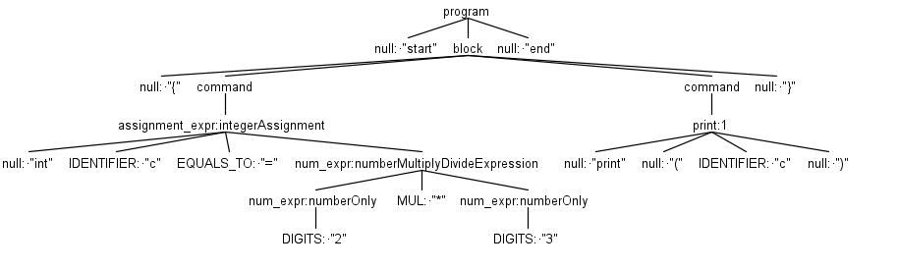
SOURCE CODE:
start
{
Int c = 2 * 3
print(:c:)
}
end
PARSE TREE:
INTERMEDIATE CODE:
LOAD ACC 2
LOAD C ACC
LOAD ACC 3
LOAD D ACC
MUL ACC C D
LOAD c ACC
PRINT c
OUTPUT:
6

Slide 12
Sample Runs

Slide 13
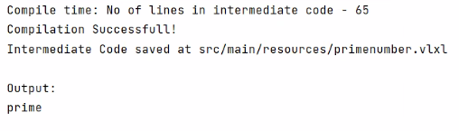
Prime Number
SOURCE CODE:
start
{
#Prime Check
int num = 19
int c = 0
for(int i=2; i<num; i++)
{
if((num-(num/i)*i) == 0)
{
c = c + 1
}
end-if
}
end-for
if (c==0)
{
print(:prime:)
}
else
{
print(:not_prime:)
}
end-else
end-if
}
end
OUTPUT:

Slide 14
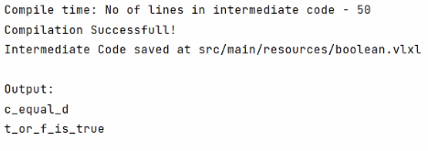
Boolean
SOURCE CODE:
start
{
int a = 10
int b = 20
int c = b - a
int d = a
if(c == d)
{
print(:c_equal_d:)
}
elseIf(c not d)
{
print(:c_not_equal_d:)
}
end-elseIf
end-if
boolean t = true
boolean f = false
if(t or f)
{
print(:t_or_f_is_true:)
}
end-if
}
end
OUTPUT:

Slide 15
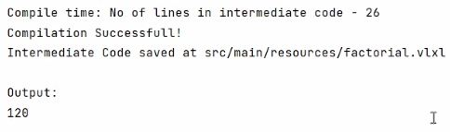
Factorial
SOURCE CODE:
start
{
#Factorial
int f = 1
int i = 5
while(i > 0)
{
f = f * i
i = i - 1
}
end-while
print(f)
}
end
OUTPUT:

Slide 16
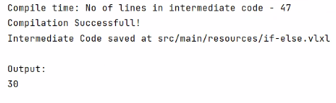
If else Statement
SOURCE CODE:
start
{
int a = 10
int b = 20
int c = 30
if((a > b) and (a > c))
{
print(a)
}
elseIf ((b > a) and (b > c))
{
print(b)
}
end-elseIf
else
{
print(c)
}
end-else
end-if
}
end
OUTPUT:

Slide 17
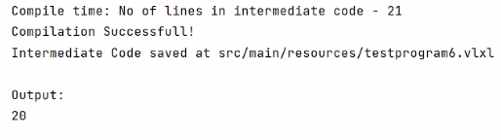
Ternary Operator
SOURCE CODE:
start
{
int a = 10
int b = 20
int c = (a > b) ? 10 : 20
print(c)
}
end
OUTPUT:

Slide 18
Future Work
New data types: Double, float
New Data structures: Lists, Maps, Stack
Multi variable declaration in one line: int p, q, r;

